Slide 1
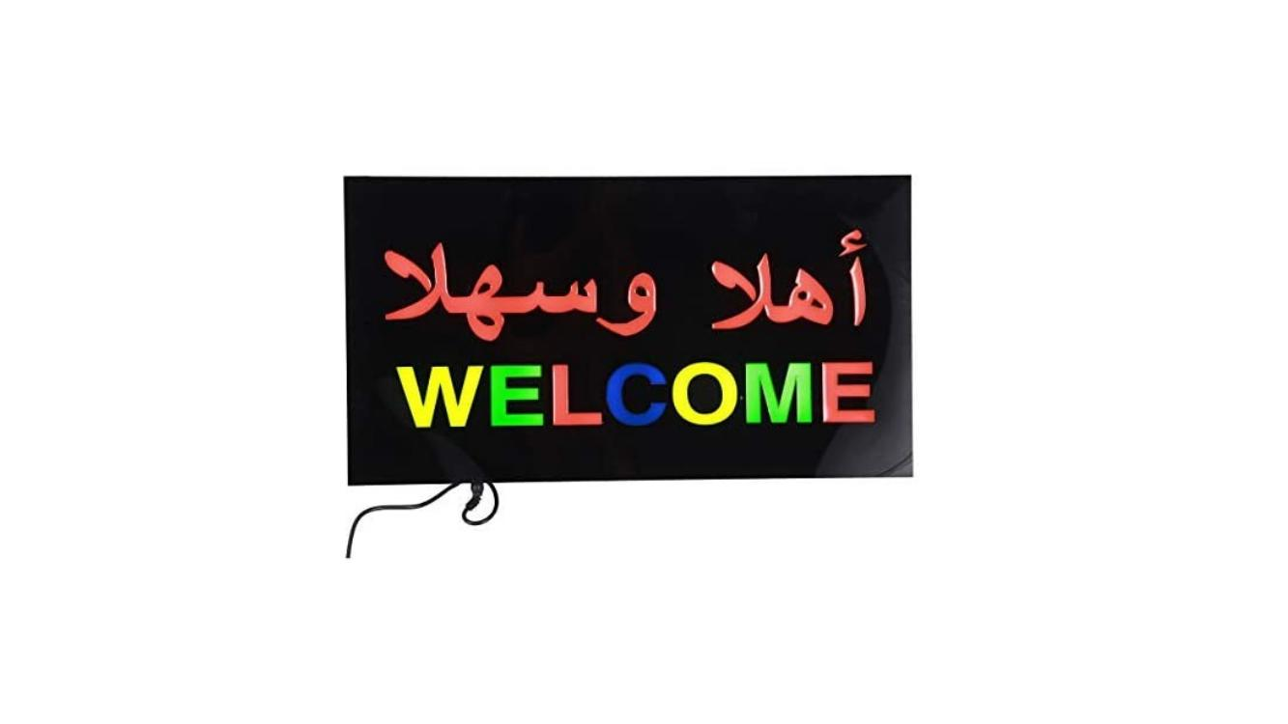
Rania AL Kaddah
رانيا القداح

Slide 2
This course will be 8 weeks. The duration of the lesson is 45 minutes. And cover…. 1) All the letters in the Arabic alphabet. 2) All pronunciation. 3) Numbers ‘1 to 10’ 4) Some words, e.g.( hello – مرحبا ) 5) Some short sentences, e.g. ( how are you – كيف حالك ) 6) Some pronouns, e.g. ( I, he, she – انا, هو, هي ) 7) Some adjectives.

Slide 3
There are 30 letters in the Arabic alphabet !
Is Arabic the 6th most spoken language in the UK?
In Arabic you read and write from left to right!
Arabic is one of the oldest languages in the world!
The Arabic language contains 12.3 million words!
True or false

Slide 4
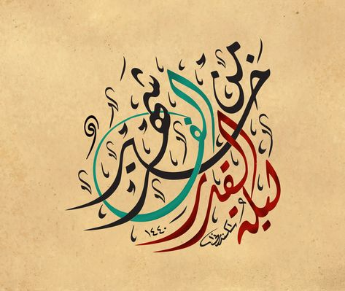
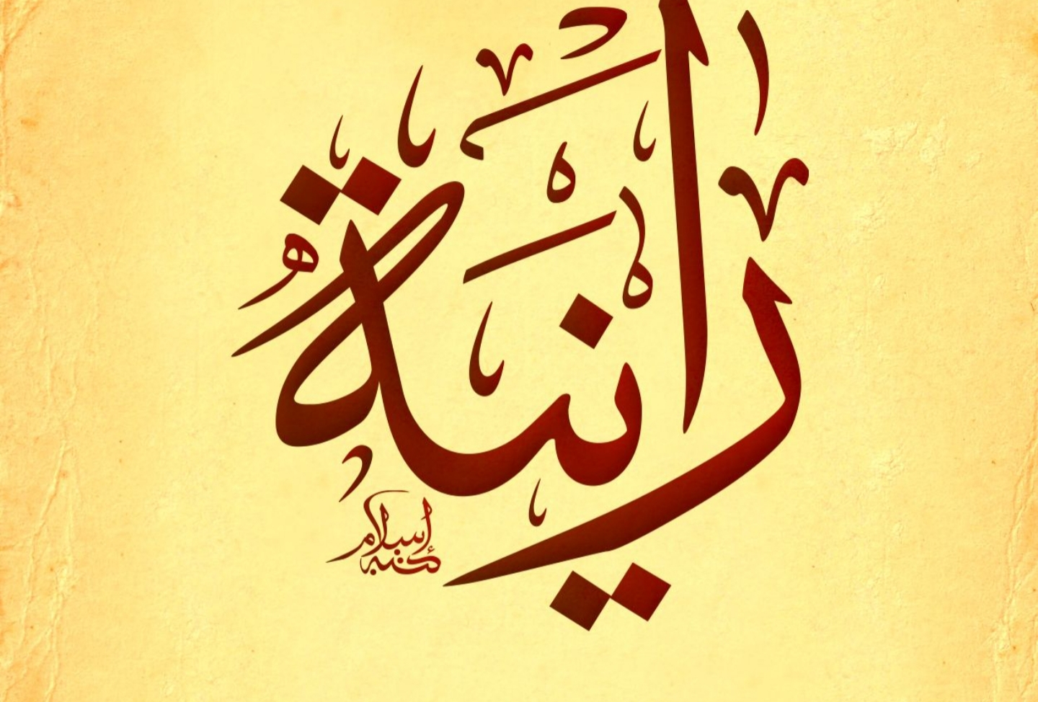
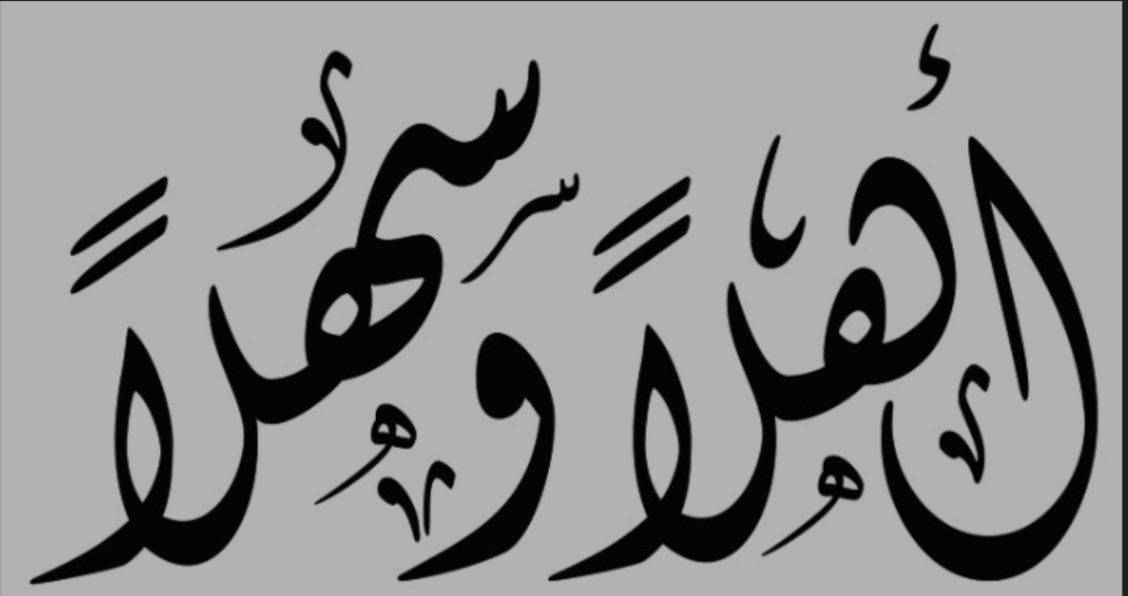
Information about the Arabic language
1) Arabic is the official language in the countries of the Arab world. 2) One of the oldest languages in the world. 3) It is the sixth most popular language spoken in the United Kingdom. 4) Arabic calligraphy is the most beautiful art in the world. 5) The Arabic language contains 12.3 million words . 6) The Arabic language Contains 28 letters. 7) Written and read from right to left. 8) It is language of the Holy Quran. 9) Some letters have four ways of writing and others have two ways.

Slide 5
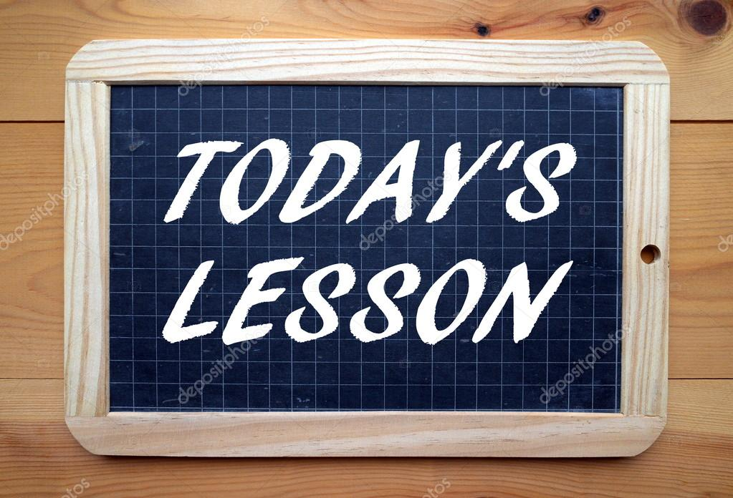
How to say ‘Hello’.
Look at all the Arabic alphabet.
Learn the first 4 letters ( ا,ب,ت ث,) pronunciation, spelling, reading and writing.
How to say ‘Goodbye’.

Slide 6
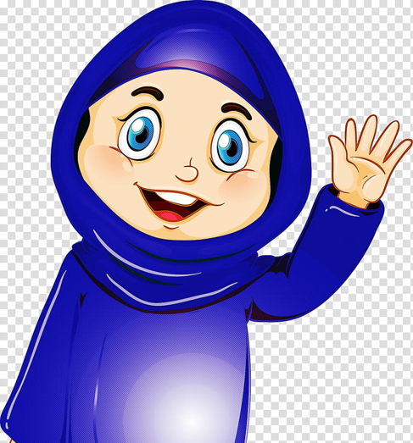
Getting started
مرحبا
Hello
Marhaba

Slide 7
Arabic alphabet

Slide 8
ا ألف
Name of the letter - Alif
Sound of the letter - aa
Asad

Slide 9
ب باء
Name of the letter - Baa
Sound of the letter - ba
Babagha

Slide 10
ت تاء
Name of the letter - Taa
Sound of the letter - ta
Timsah

Slide 11
ث
ثاء
Name of the letter – Thaa
Sound of the letter - tha
Thalab

Slide 12
Google your own name and write it down in Arabic for next lesson.

Slide 13
Next lesson on 27th of April at 10.00 am
Go to Maun Refuge website http://www.maunrefuge.org.uk/

Slide 14
مع السلامة
Maa Al Salama
Goodbye

