Slide 1
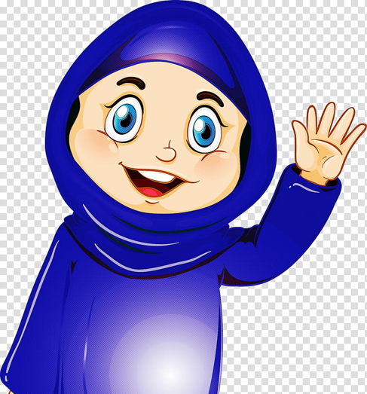
Getting started
مرحبا
Hello
Marhaba

Slide 2
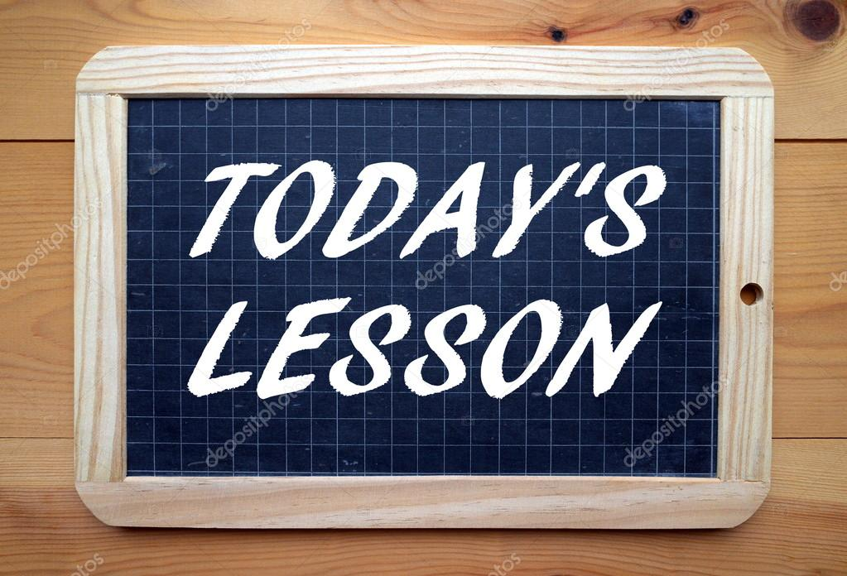
How to say (how are you) ( good – bad )
A quick review of lesson one.
Look at the homework.
Learn 3 letters ( ج, ح, خ) pronunciation, spelling, reading and writing.

Slide 3
كيف حالك؟
Kayf halik

Slide 4
جيد
Good
Jayid

Slide 5
سيء
Bad
Siiy

Slide 6
Arabic alphabet

Slide 7
ج
جيم
Name of the letter – Jiim
Sound of the letter - ja
Jamal

Slide 8
ح
حاء
Name of the letter – Haa
Sound of the letter - ha
Hesaan

Slide 9
خ
خاء
Name of the letter – Khaa
Sound of the letter - kha
Kharouf

Slide 10
Writing letters from ( ا to خ )

Slide 11
-Next lesson on 4th of May at 10.00 am
-Go to Maun Refuge website http://www.maunrefuge.org.uk/

Slide 12
مع السلامة
Maa AL Salama
Goodbye

