Slide 4
د

Slide 5
ذ ذال

Slide 6
ر راء

Slide 7
ز زاي

Slide 8
Personal Pronouns and Verb To Be

Slide 10
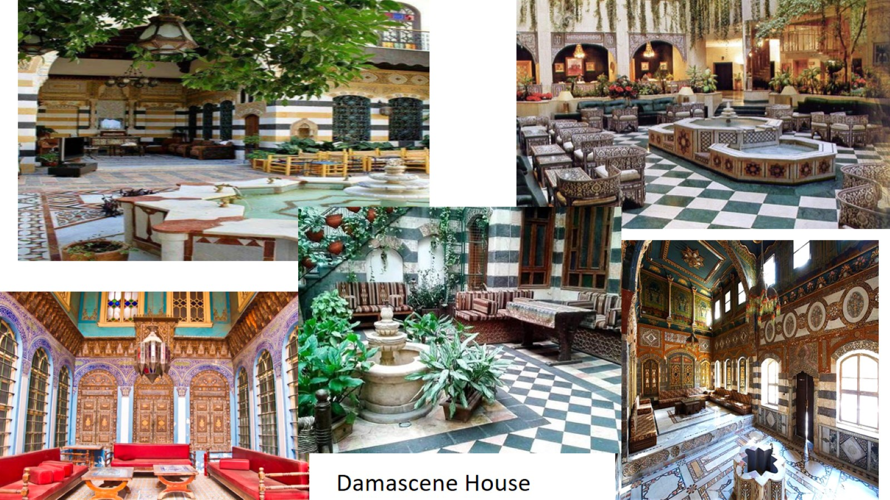

Slide 12
Next lesson on 11th of May at 10.00 am

