Slide 1
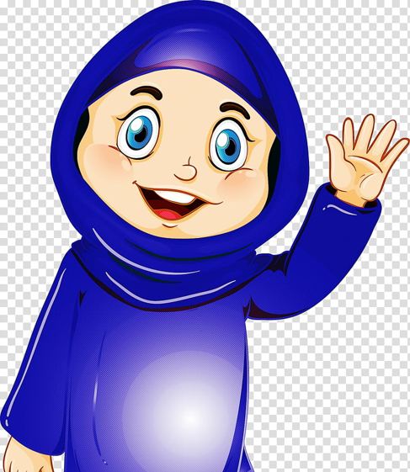
مرحبا
Hello
Marhaba

Slide 2
Review homework and Lesson 4
Learn 4 new letters (ط, ظ, ع, غ)
Learn numbers (1, 2, 3)
How to say (father, mother)

Slide 3
Arabic Alphabet

Slide 4
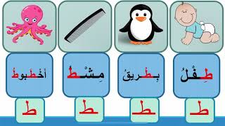
ط طاء
Name of the letter - taa
Sound of the letter - ta
Taawoos

Slide 5
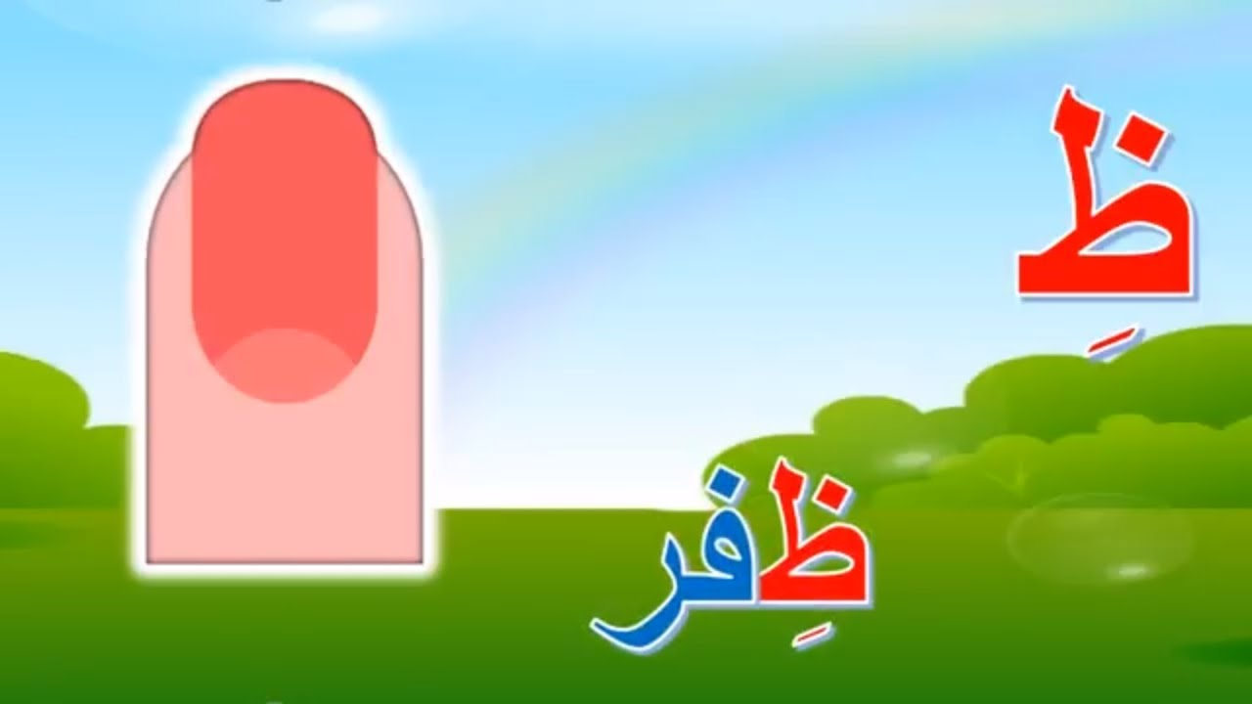
ظ ظاء
Name of the letter - thaa
Sound of the letter - tha
Thefer

Slide 6
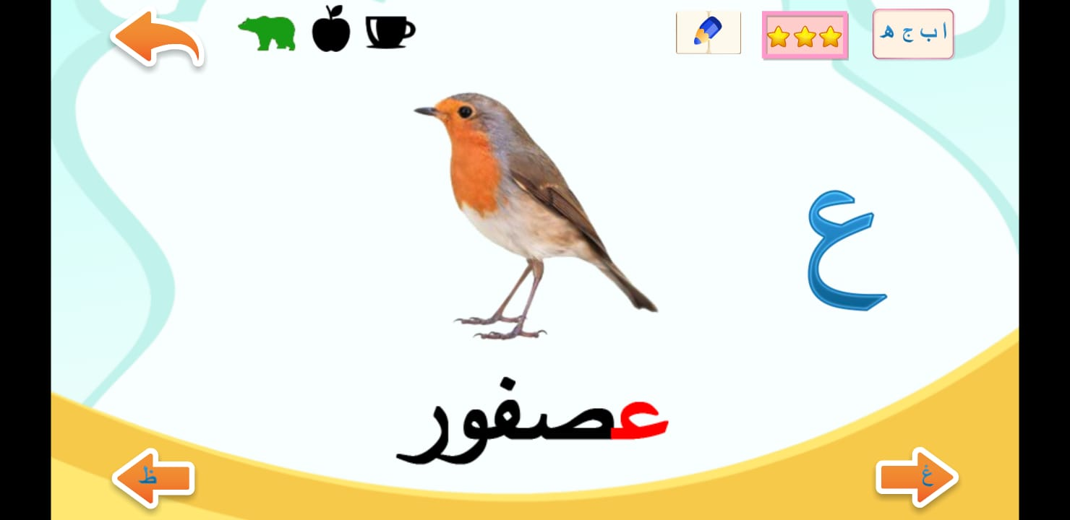
ع عين
Name of the letter - ayn
Sound of the letter - aa
Asfoor

Slide 7
غ غين
Name of the letter - ghayn
Sound of the letter - gha
Ghorab

Slide 8
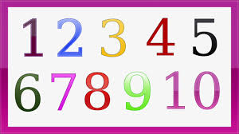
Numbers
الأرقام

Slide 9
one
Waahid

Slide 10
اثنان
Two
Ithnaan

Slide 11
ثلاثة
Three
Thalathah

Slide 12
أب
‘ab
Father

Slide 13
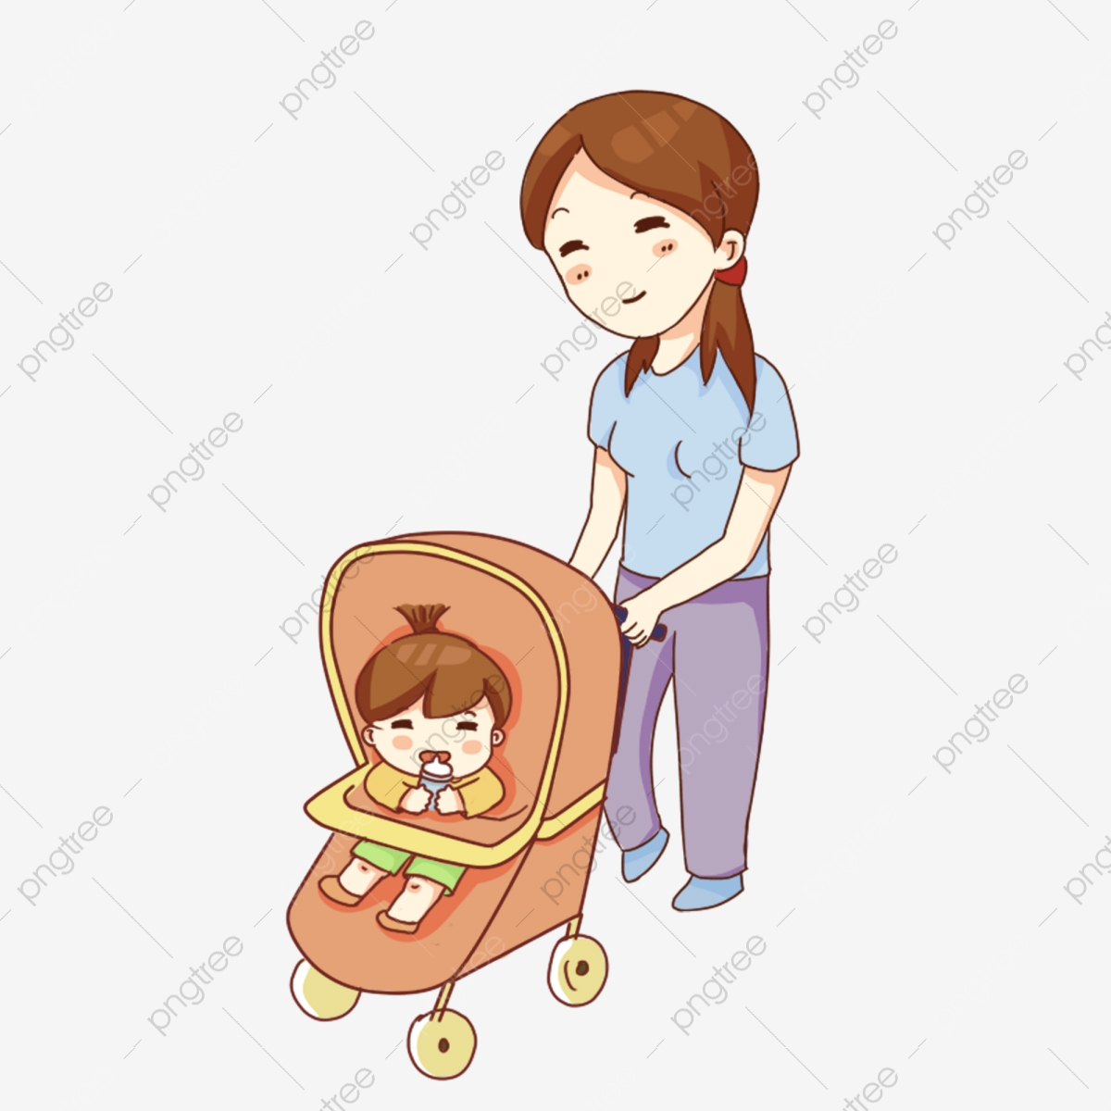
أم
‘um
Mother

Slide 14
No homework

Slide 15
Next lesson on 25th of May at 10.00 am
Go to Maun Refuge website http://www.maunrefuge.org.uk

Slide 16
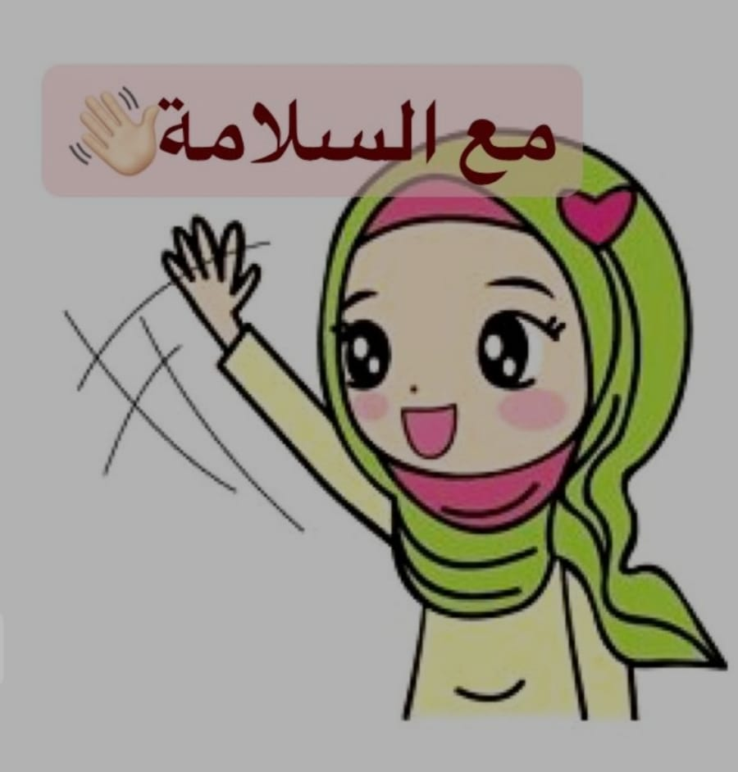
مع السلامة
Maa AL Salama
Goodbye

