Slide 1
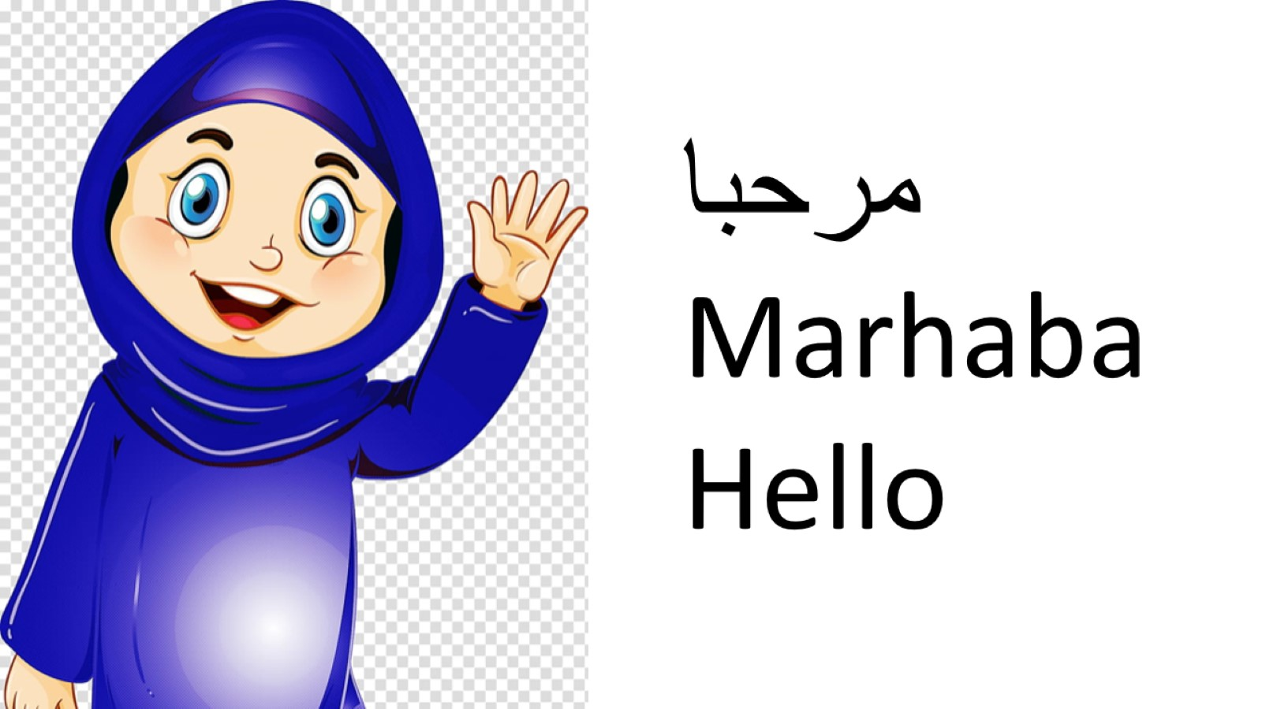

Slide 3
Arabic Alphabet

Slide 6
ك كاف

Slide 8
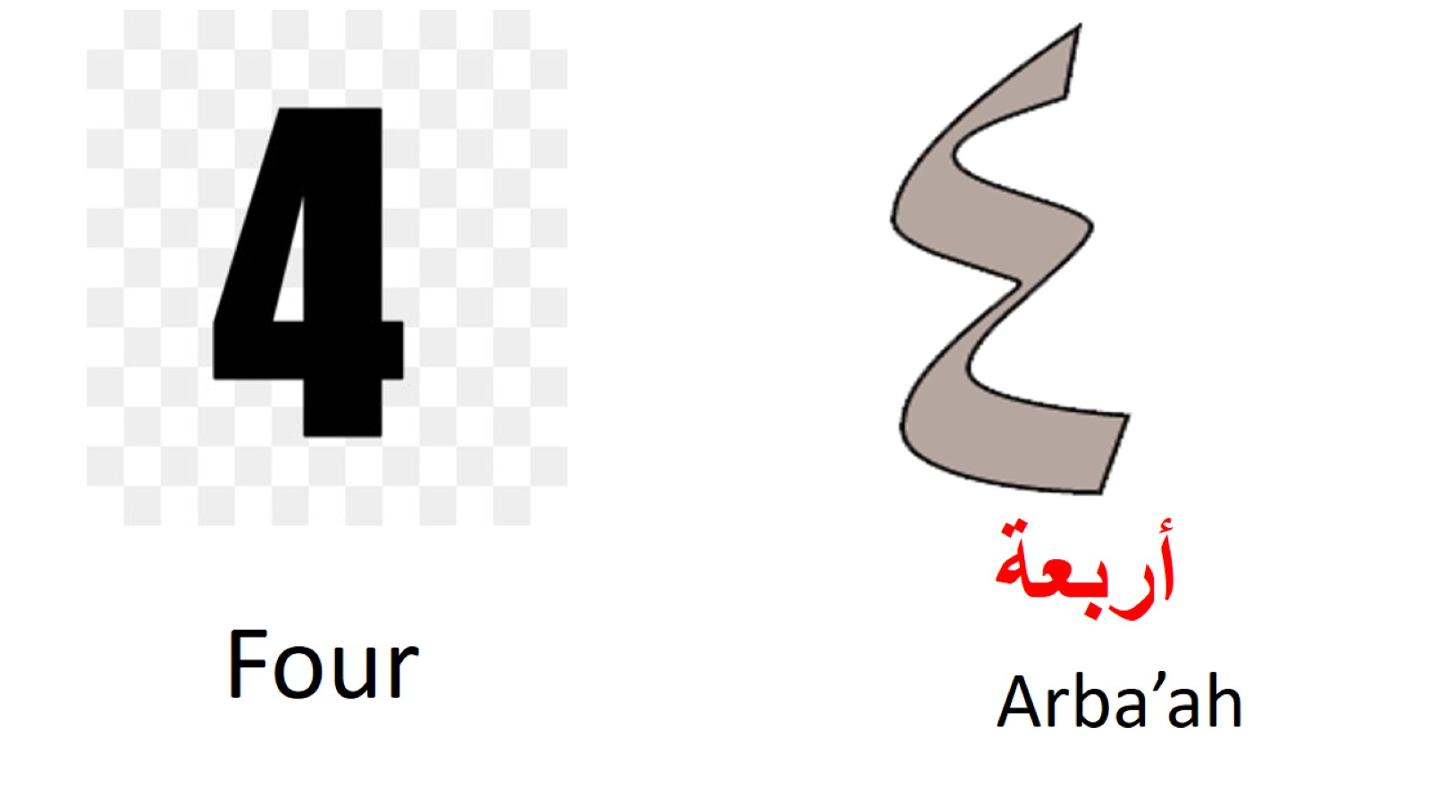

Slide 9
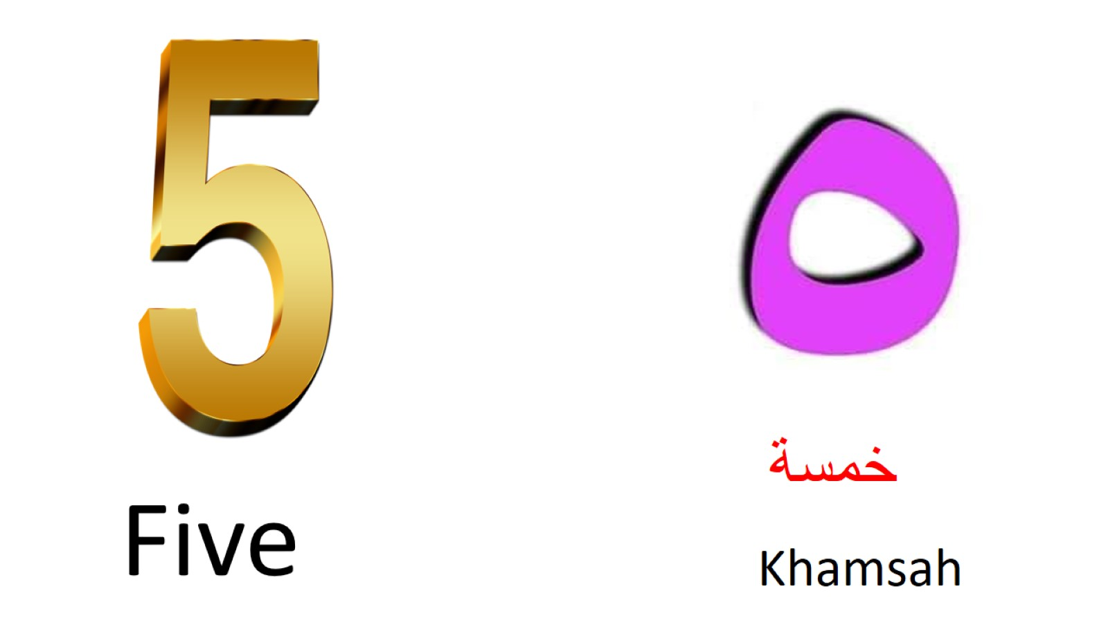

Slide 12
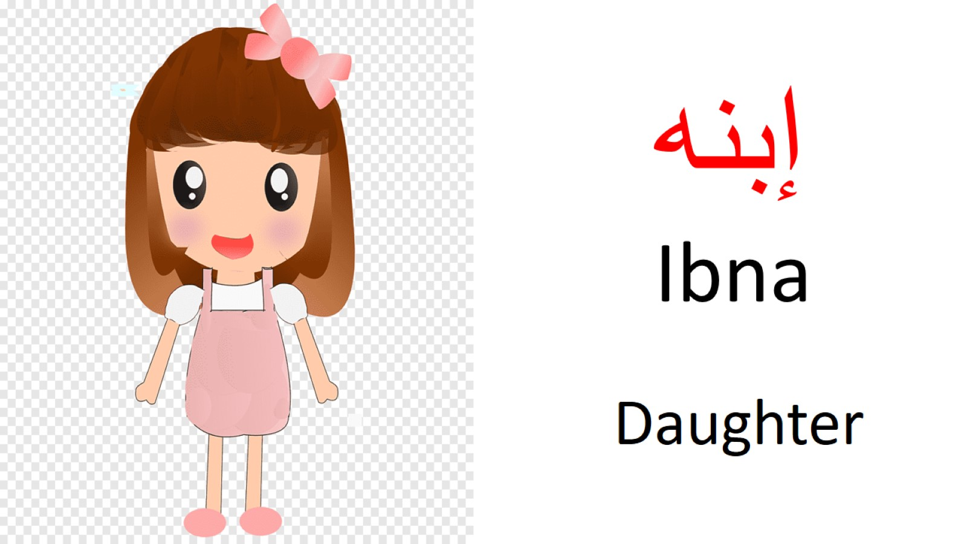

Slide 14
Next lesson on 1st of June at 10.00 am

