Slide 1
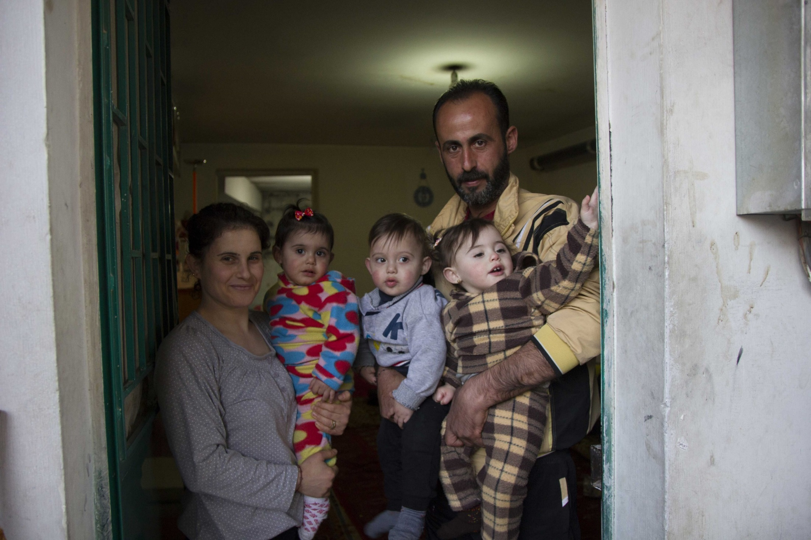
Refugee week 2026.
Refugees: What’s the Reality?
🌍
Like many others, Abir and Tony’s family fled from Syria to Lebanon, a neighbouring country.

Slide 2
Which of these statements might be misunderstandings?
Most refugees
have chosen to leave
UK takes most refugees
Refugees can easily work
Asylum seekers get
council houses
🗳️

Slide 3
Let’s check the facts
Most refugees stay near their
home countries
UK is not the largest host
(Turkey is one of the largest!)
Most adults are not allowed
to work straight away
Asylum seekers are housed in
special rooms in shared houses
(none in hotels or council houses in Mansfield)
✅

Slide 4
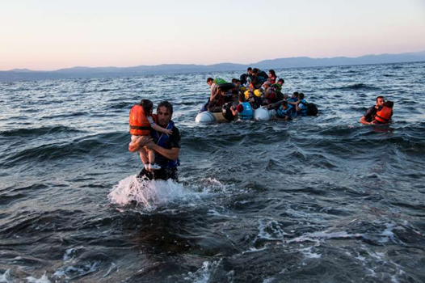
What is a refugee?
Refugee
A refugee is someone who has been forced to leave their country because they are not safe, and their need is recognised.
Asylum Seeker
Is still waiting for a decision to see if they can stay in the UK.

Slide 5
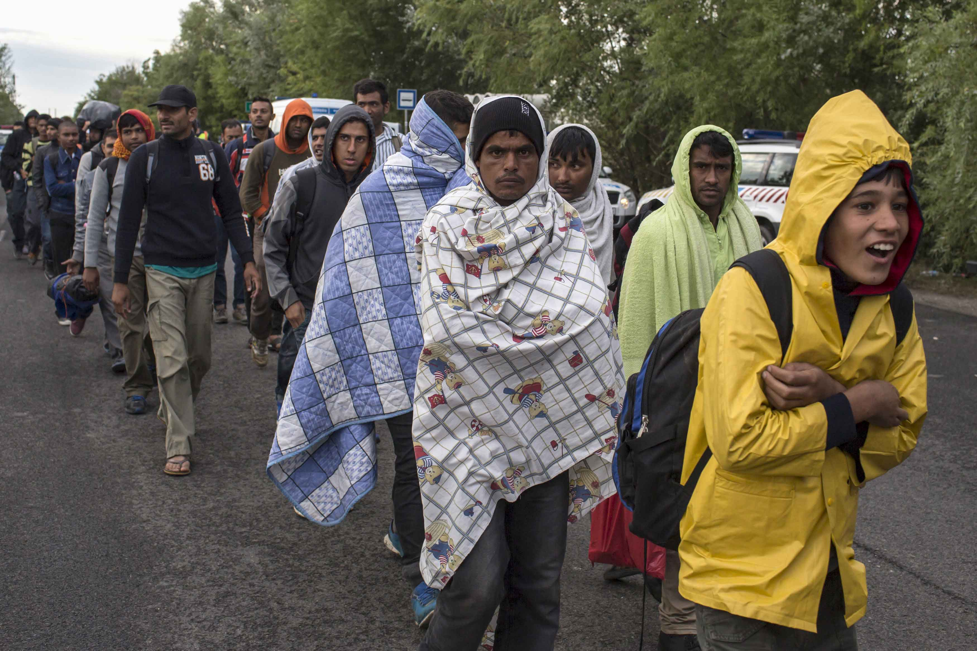
Why do people leave?
War
Violence
Persecution
⚠️

Slide 6
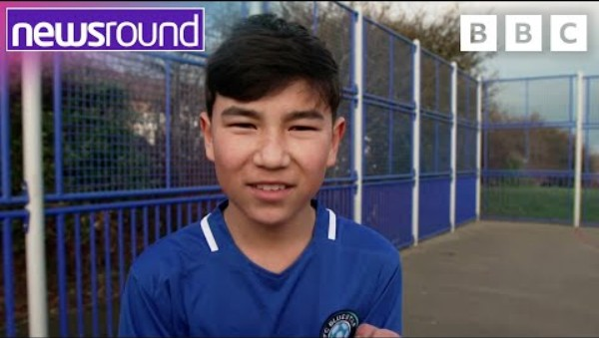
This is a real story
Notes:
https://www.youtube.com/watch?v=STchQkVchlg

Slide 7
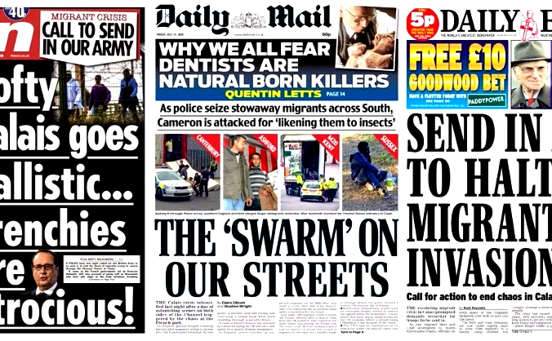
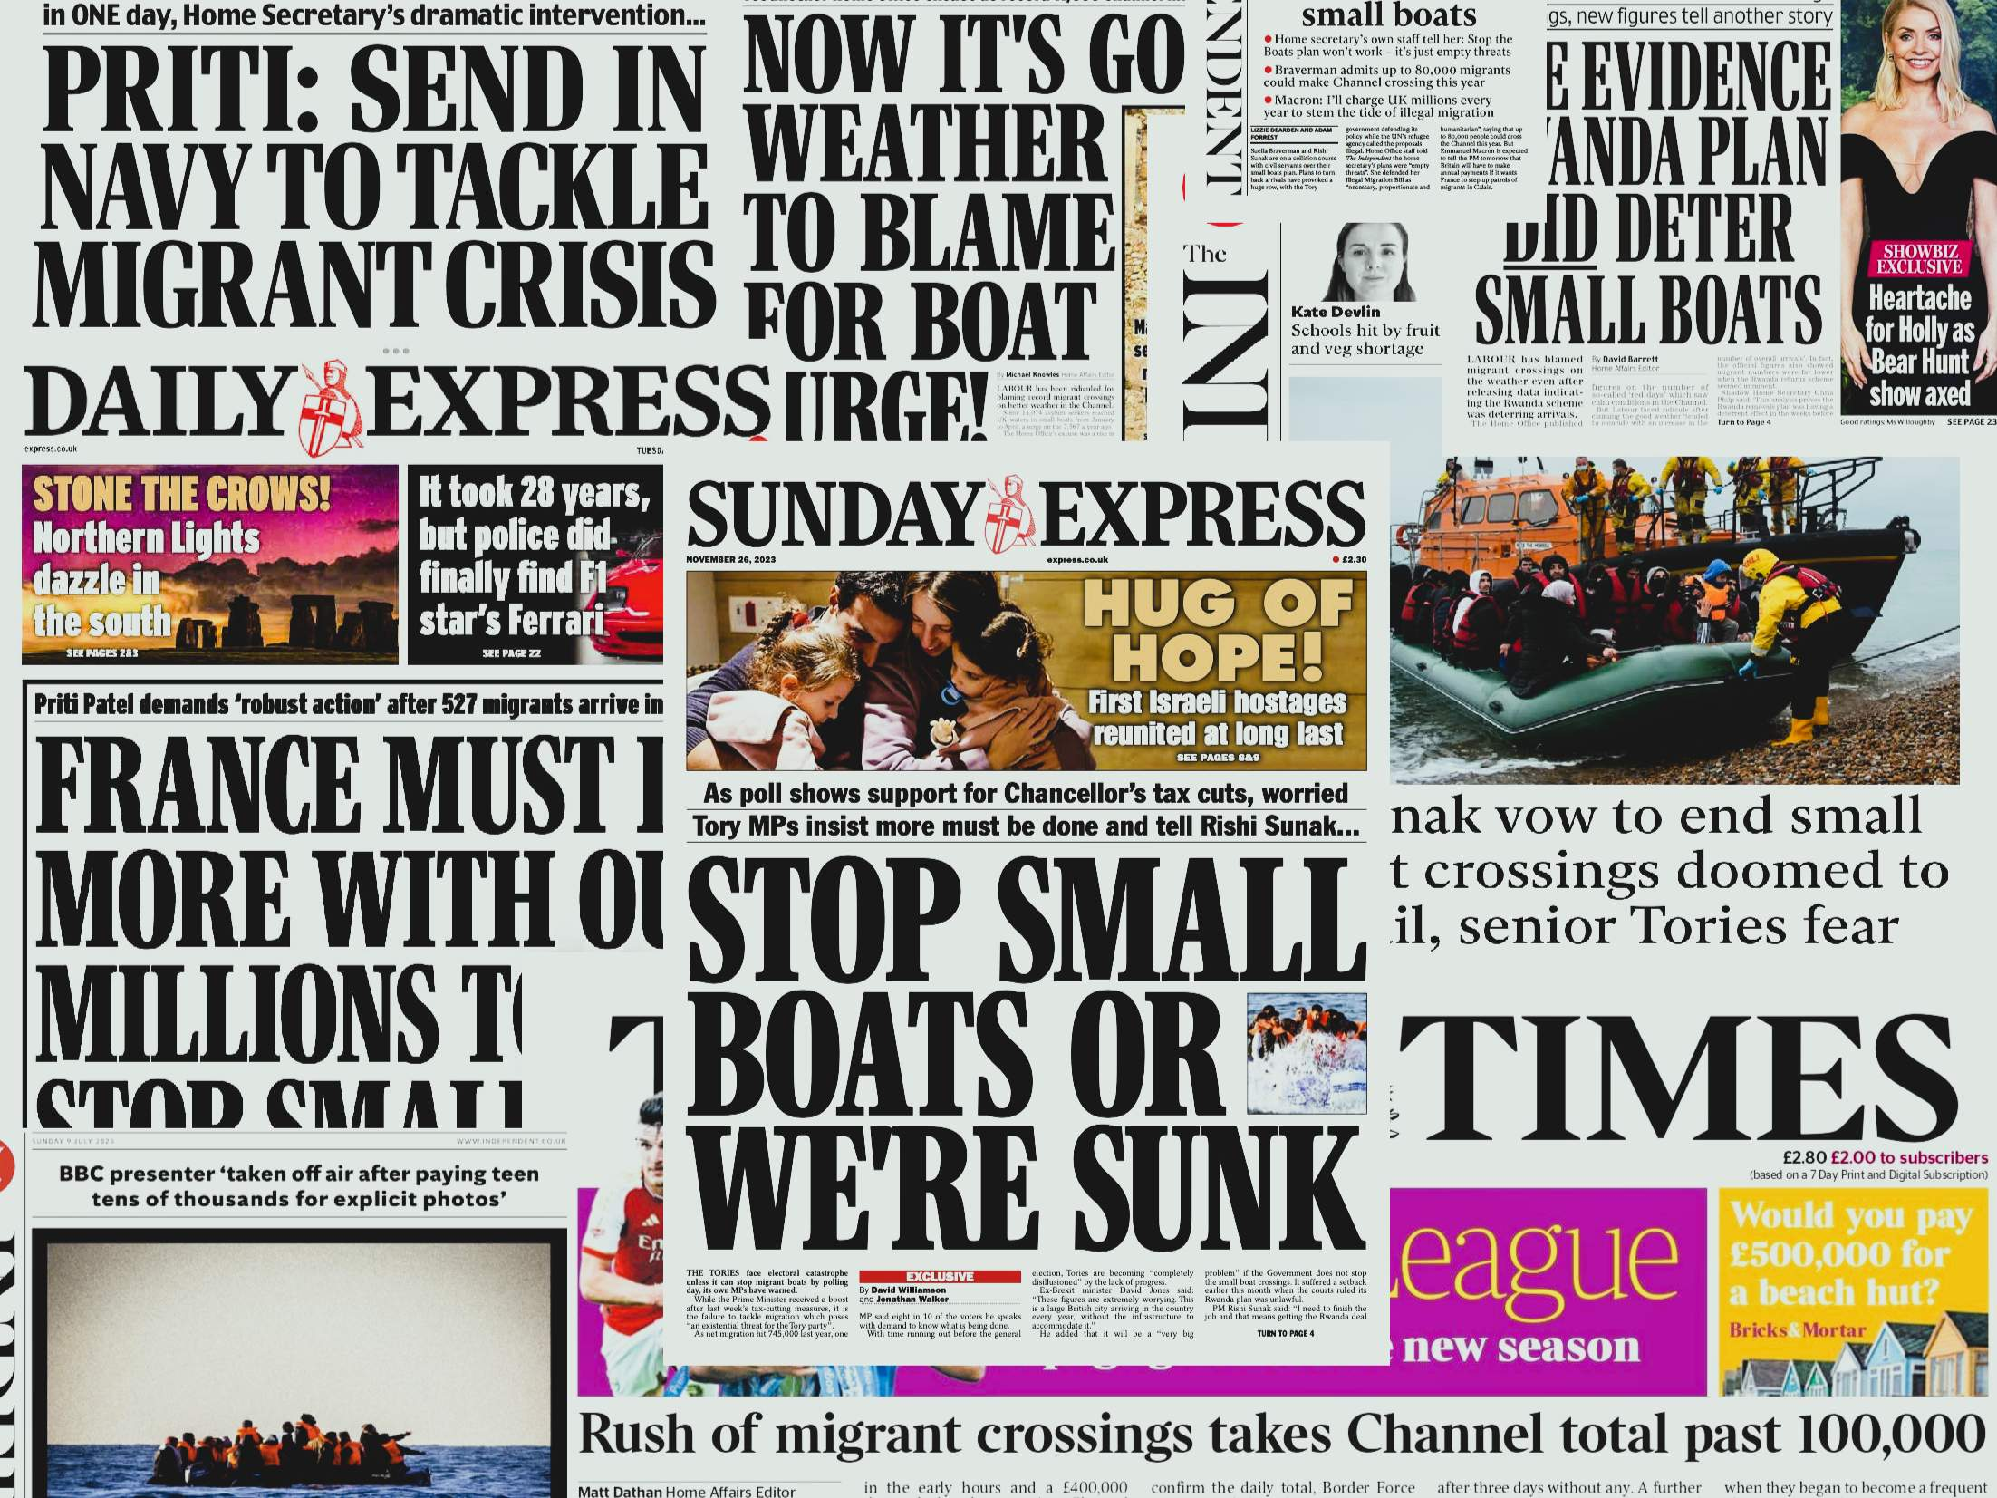
Where do opinions come from?
Social media
News
Friends and family
What have you heard?
“Are these sources always reliable?”
“How can we tell?”
📱

Slide 8
Our local area
Local facts and something to think about
In Mansfield we have refugees and
asylum seekers from over 80 war torn countries
Maun Refuge, a local charity that helps them,
has around 280 people that it helps.
Asylum seekers are not allowed to work or apply for benefits
while their claim for refugee status is being considered.
Having no right to work, families survive on just £49.18
per week per person (around £7 per day).
That is for food, clothing, mobile phones and toiletries.
How would your family cope on that money?
📍

Slide 9
Words matter
Words can include or exclude
Think before we speak
Be kind
💬

Slide 10
How would you like to be treated?

Slide 11
Reflection
In the UK, we value respect, tolerance and fairness – this helps everyone feel safe and included.
One thing I will do differently this week is…
🤔

