Slide 1
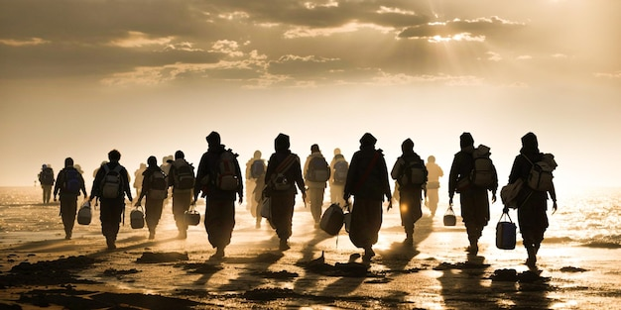
Refugees in the UK: Facts, Myths and Choices
🌍

Slide 2
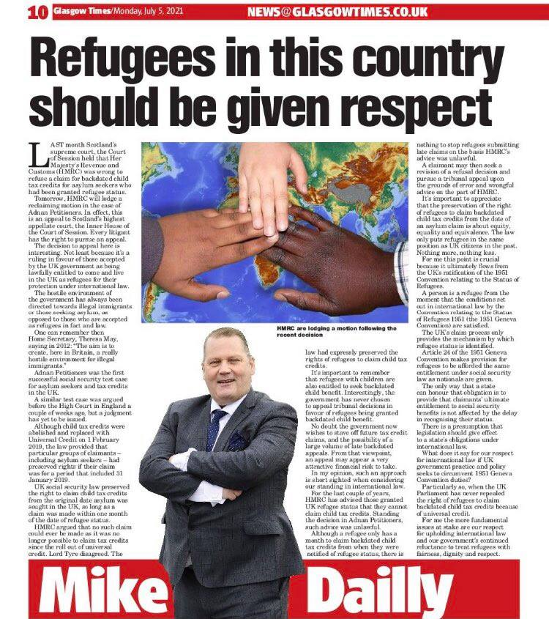
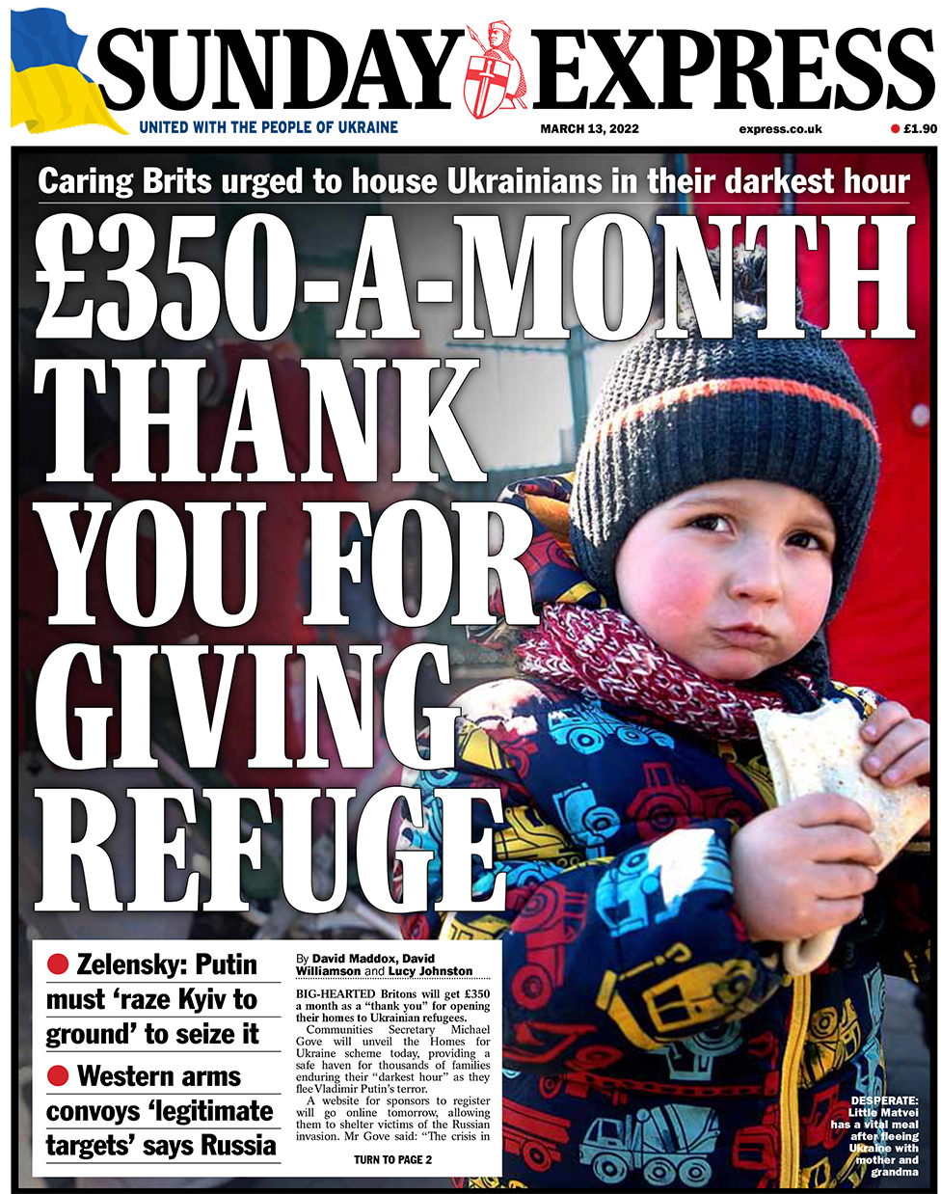
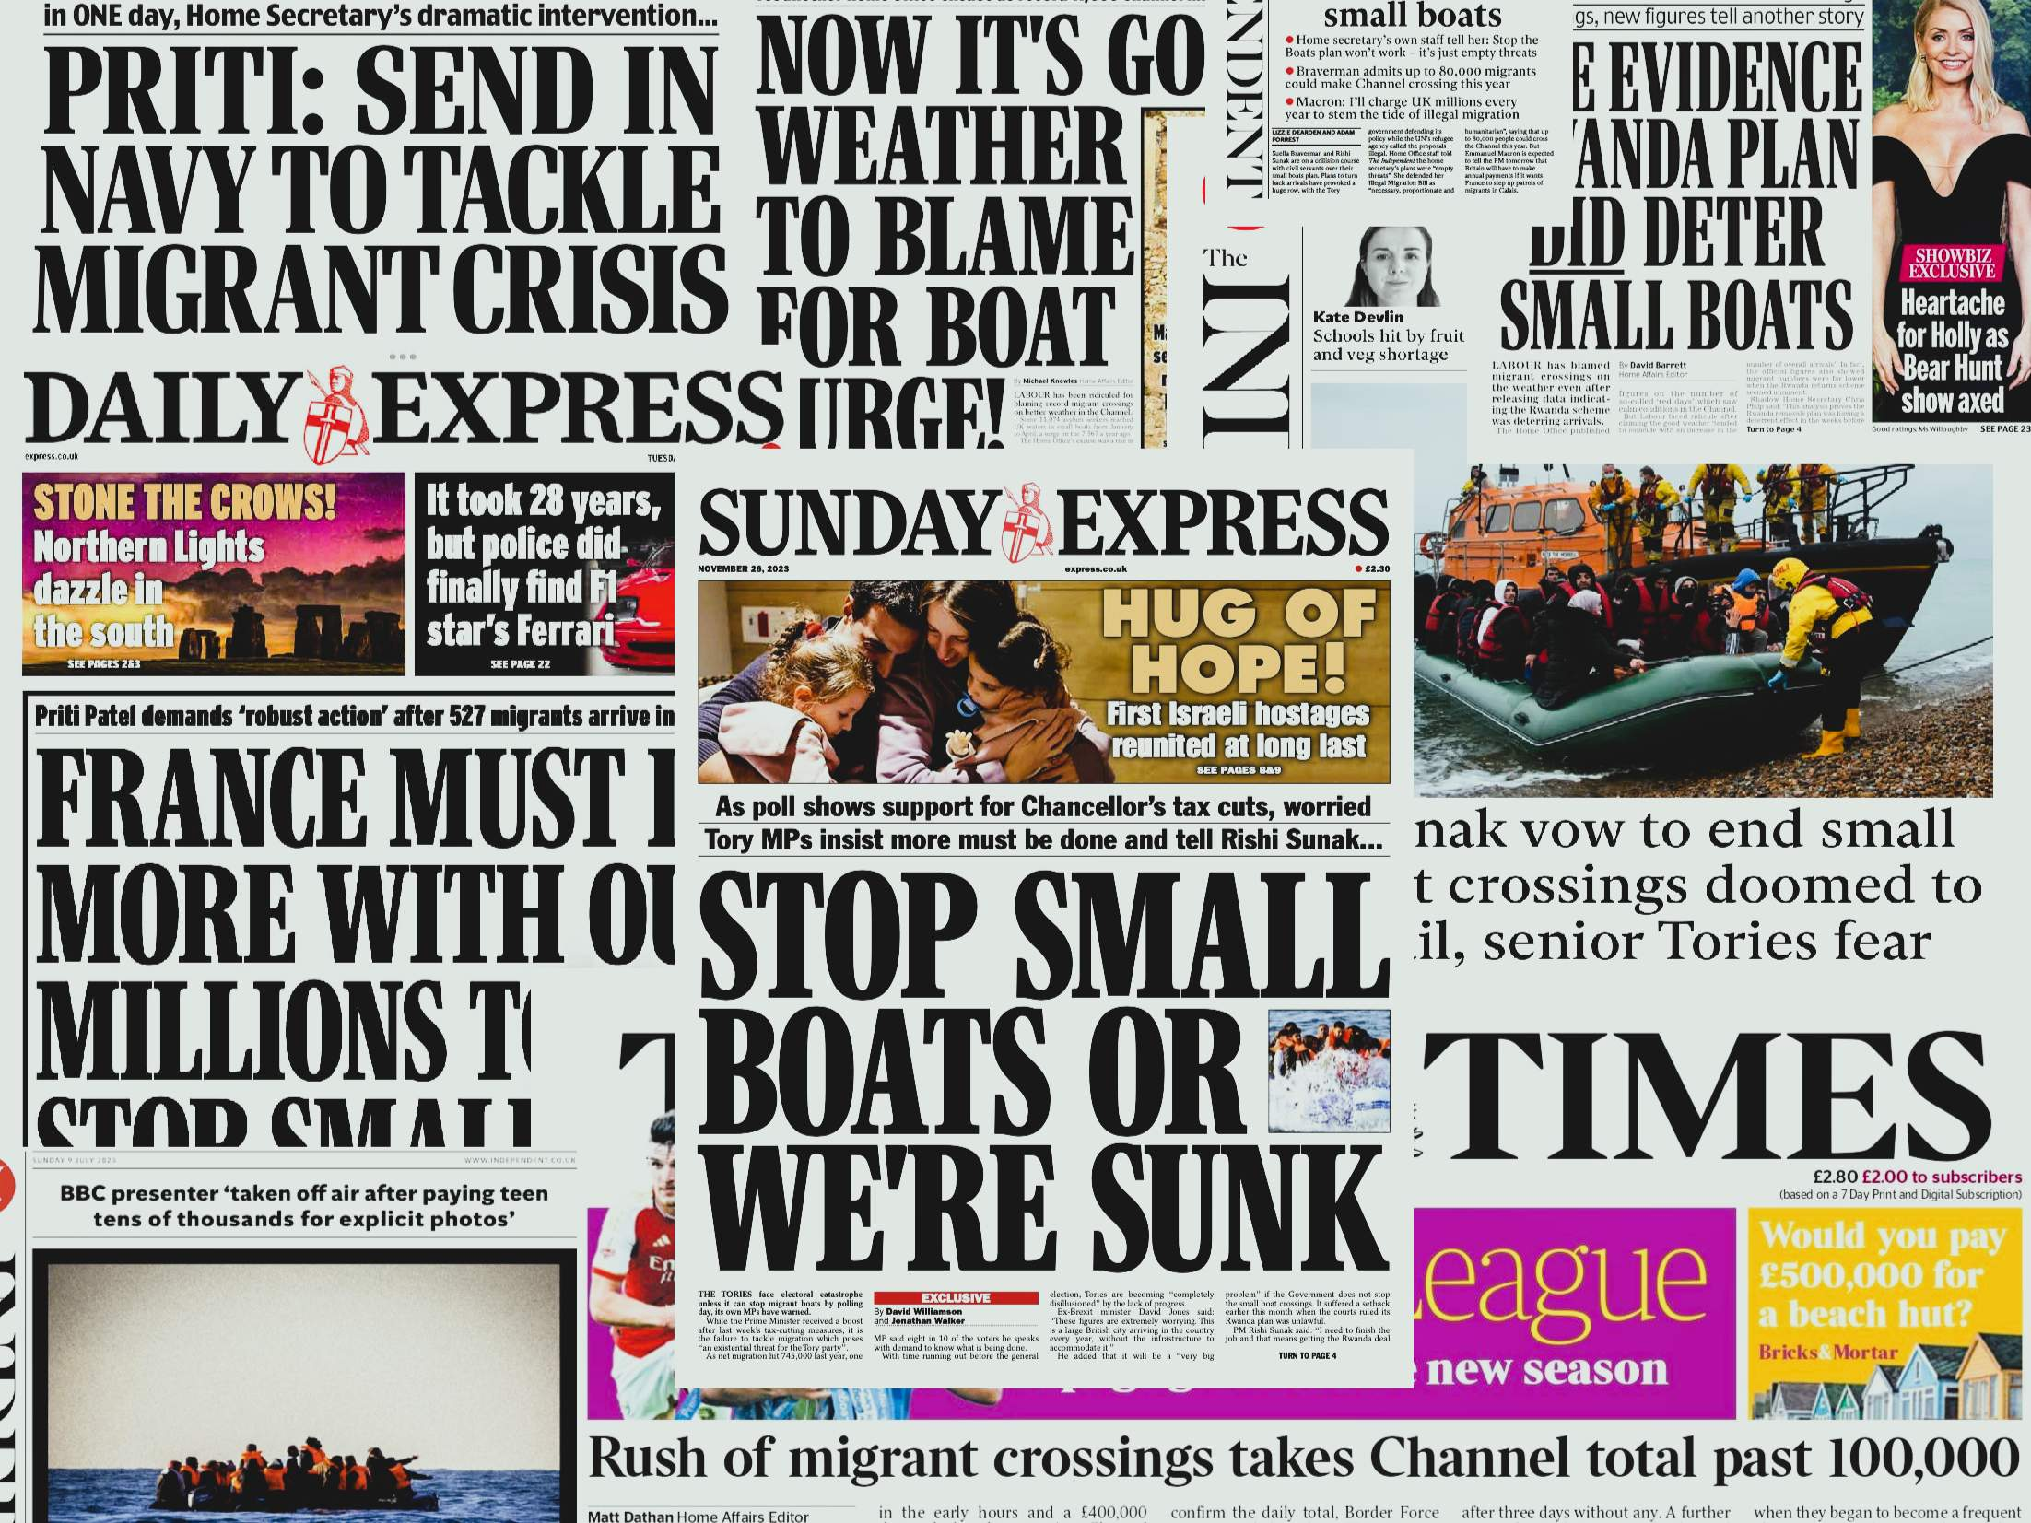
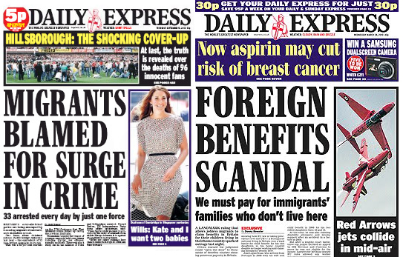
The debate
Different headlines can present the same
issue very differently
📰

Slide 3
Definitions
Refugee:
Legally recognised as needing protection
Asylum seeker:
Is waiting for a decision to see if they can stay
📘
I’ve been wating over a year to see if I can stay. I am not allowed to work and I have to live in a shared hostel on £7 a day. I need a coat, it’s getting cold.

Slide 4
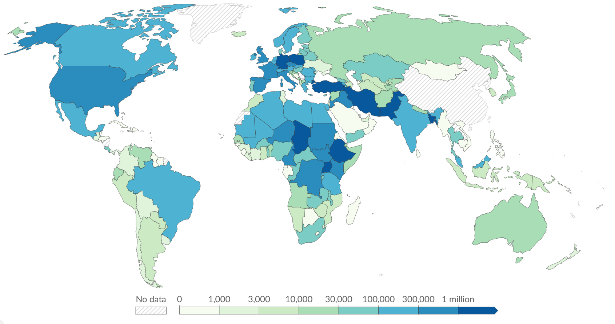
Global reality
Most refugees stay in neighbouring countries, not the UK

Slide 5
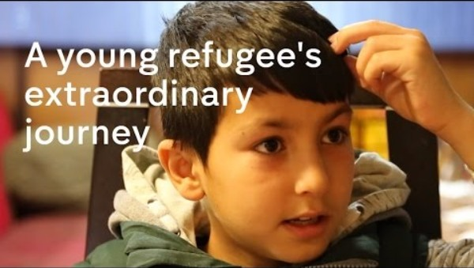
A real journey
Notes:
https://www.youtube.com/watch?v=FGCe5T-DnRY

Slide 6
Common claims
They get everything for free
They take jobs
They are all the same
⚠️

Slide 7
UK reality
Long asylum process can take months or over a year
No right to work until
asylum is granted
Basic financial support
Shared accommodation
✅

Slide 8
Local context
In Mansfield, we have families who have come from many different countries because they were not safe.
• Maun Refuge is a local charity that helps around 280 people, including children, with things like food, clothes and support.
• While they are waiting for a decision, some families are not allowed to work or earn money.
• Families have to live on about £7 per person each day for everything they need.
🔴 Would that be easy or difficult for your family?
📍

Slide 9
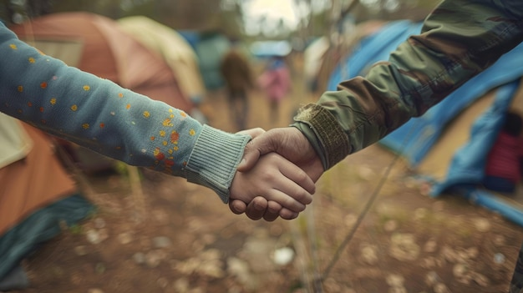
Ethical question
What responsibility do
we have to people fleeing
danger?
⚖️

Slide 10
Final thoughts
Think carefully
Facts + Understanding = Better judgement
Act responsibly
Respect others
Be fair in what you say
Challenge misinformation
🤔

